Slide 1

Doctor Fee Prediction
in different Cities
Prepared By:-
Vidya Shree (pd14_173)
Aishwarya Singh Gaur (pd14_191)

Slide 2
Problem Statement
To build a ML Project to predict the consultancy fee of Doctors on Practo website.
For this project we have to Scrape the doctors’ data from Practo website using python library called Beautifulsoup and collect information like:
Name - Name of the doctor
Specialty of doctor - Their specialty like dentist, Gynecologist, pediatrician etc.
Degree type - like MBBS, MS, MD, BDS etc.
Year of experience - Total year of experience Location - Location of clinic
City - City of the clinic
Dp score - This will be doctor patient experience score
npv - Number of people votes
Consult fee - Consultation fee at clinic

Slide 3
Work Flow
Data Collection Via Web Scraping
Data Cleaning
ML Model
Analysis
Dashboard
Insights
We have used BeautifulSoup and Selenium library in python for Data collection.
For Data cleaning we have used Python.
For analysis we have used Excel Pivot tables.
We have created Dashboard using Excel.

Slide 4
Web Scraping
We have divided web scraping into two parts:
We have extracted links to open each doctors profile.
From that link we have extracted required features.

Slide 5
Doctors In Each City

Slide 6
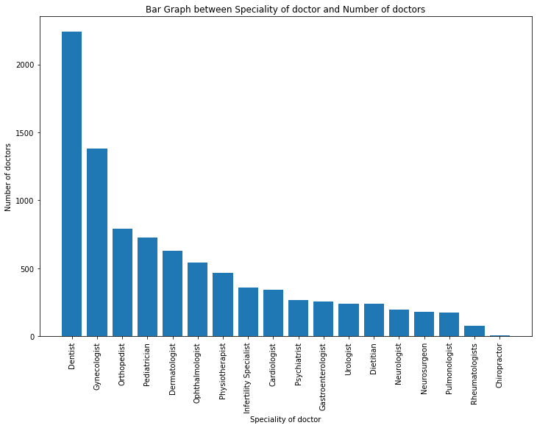
Number of Doctors with different Specialties

Slide 7
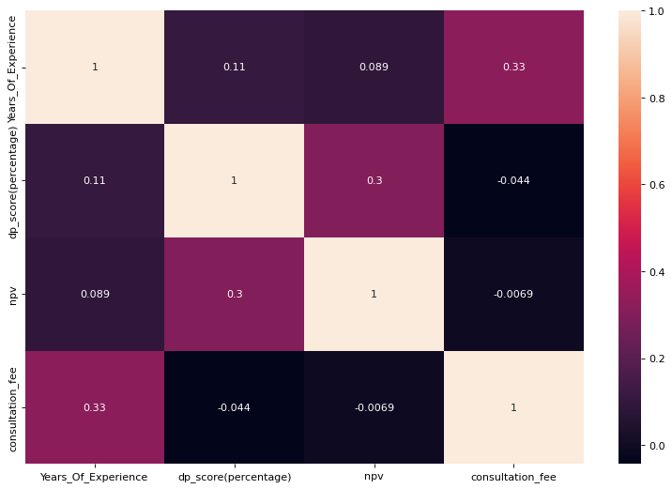
Correlation-Heat Map

Slide 8
Linear Regression Model
Before PCA
RMSE : 201.42297433927857
R2 Score: 0.48357350005816313
After PCA
RMSE : 199.1332641311188
R2 Score: 0.4825893423078844

Slide 9
THANK YOU

